Slide 2
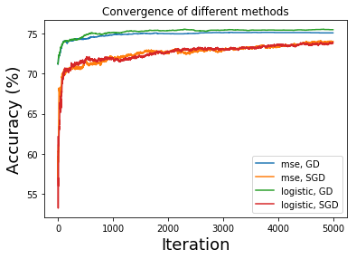
Step 1: 5000 iter
75.12
0.7807688518377245
74.06
1.6463292501805349
75.52
1.2890306435457624
73.88
1.0851727973000436
Prob: optimal st size of GD and SGD are different

Slide 3
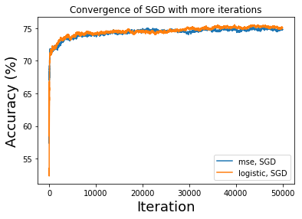
Step 1: 50000 iter for SGD
74.78
1.0283968105745958
75.0
0.9633275663033856

Slide 4
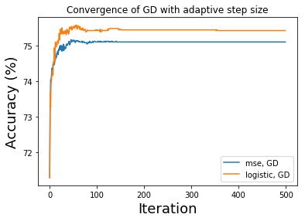
Step 2: adaptive stepsize for GD
75.1
0.7456540752922918
75.42
0.810925397308531

